Slide 1
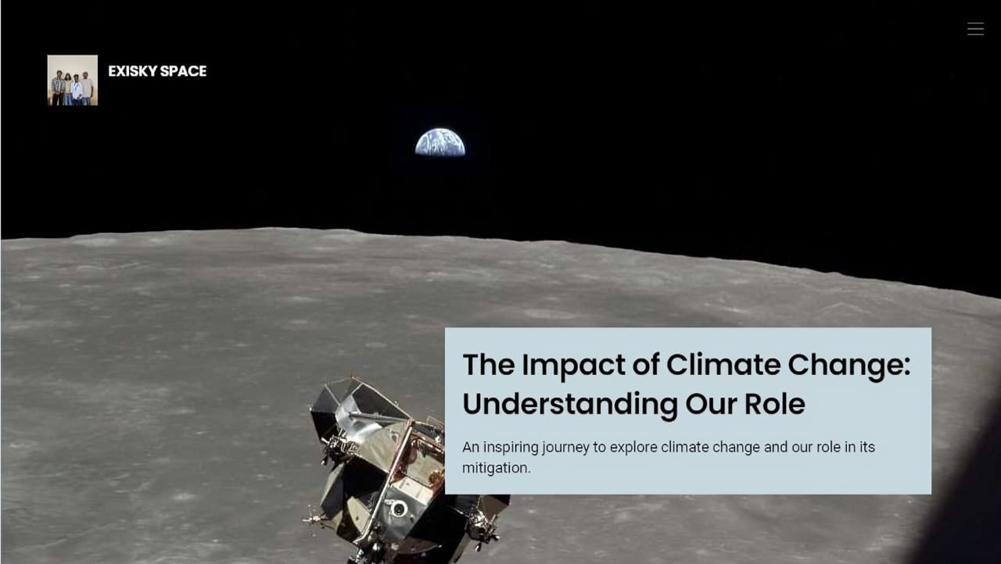

Slide 2


Slide 3
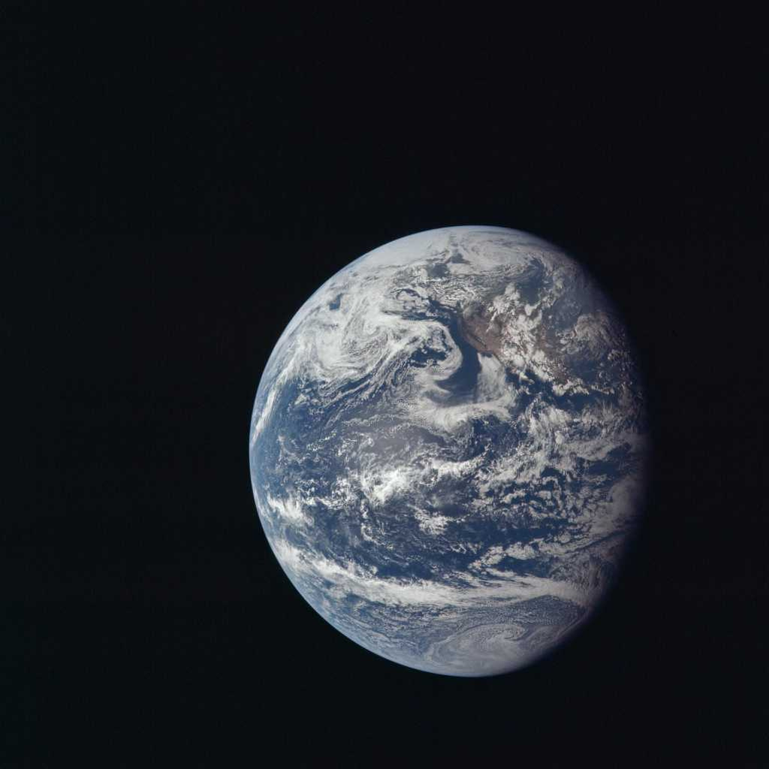
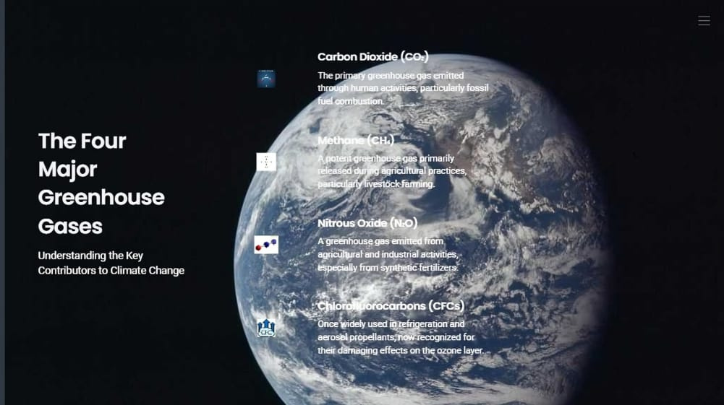

Slide 4

Methane (CH₄)
Produced during the breakdown of organic matter in landfills, agriculture (especially from livestock), and natural gas production.
Carbon Dioxide (CO₂)
Released from burning fossil fuels (coal, oil, natural gas), deforestation, and land-use changes.

Slide 5
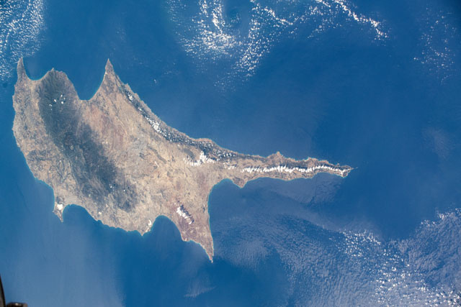
Nitrous Oxide (N₂O)
Chlorofluorocarbons (CFCs)
Emitted from agricultural and industrial activities, as well as during combustion of fossil fuels and solid waste.
Historically used in refrigeration, air conditioning, foam-blowing agents, and aerosol propellants.

Slide 6
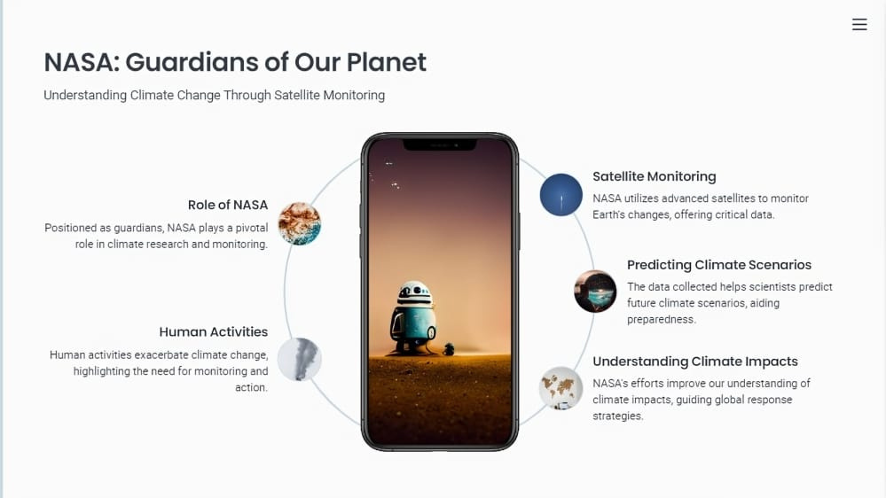

Slide 7
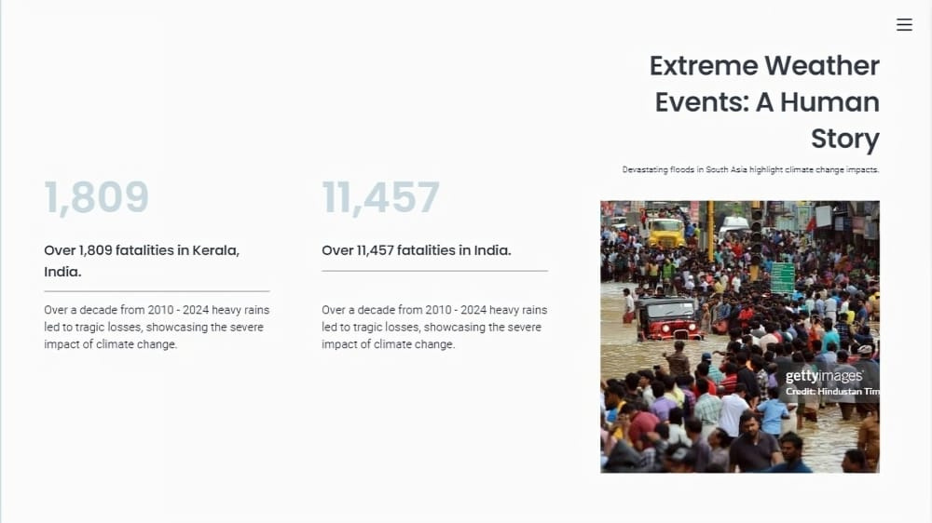

Slide 8
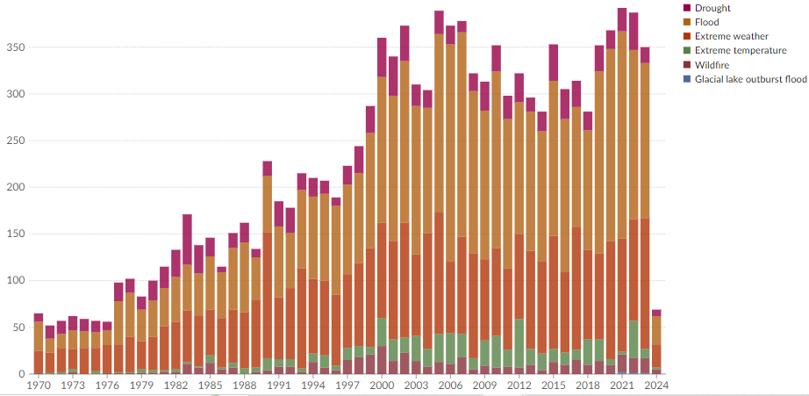
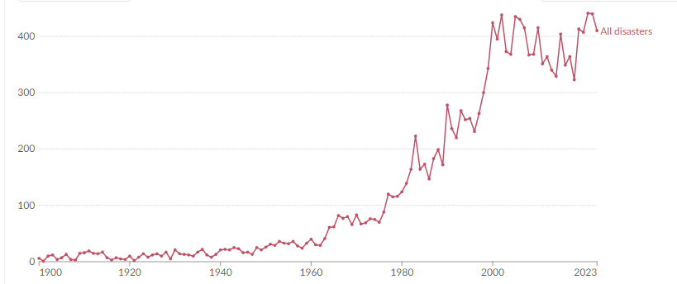
CASE STUDY
On increasing greenhouse gases and the climate change caused by it

Slide 9
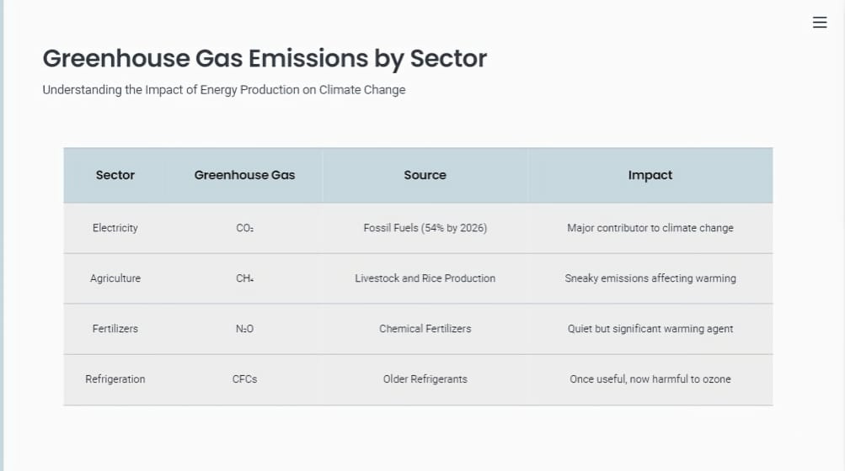

Slide 10
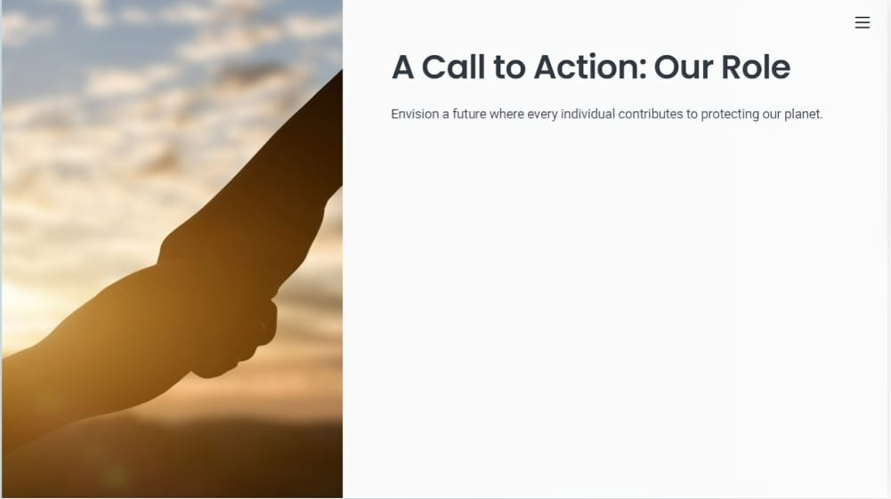
A FEW THINGS WE CAN DO
Reduce Energy Use
Limit Car Travel
Minimize Waste
Support Sustainable Practices

Slide 11
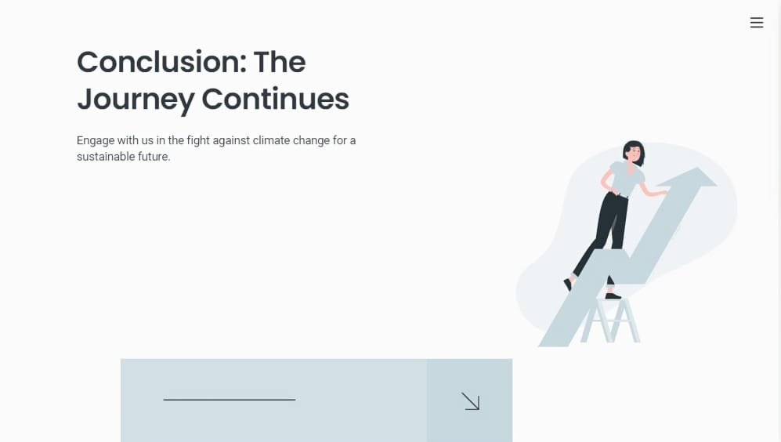

Slide 12

Presented by
EXISKY SPACE
OJES
ABHINAV
AL AMEEN
BINJU

